Slide 1

Command Line Arguments

Slide 2
It is possible to pass some values from the command line to your C programs, when they are executed.
These values are called command line arguments.
The command line arguments are handled using main() function arguments argc and argv[].
argc refers to the number of arguments passed and argv[] is a pointer array which points to each argument passed to the program.

Slide 3
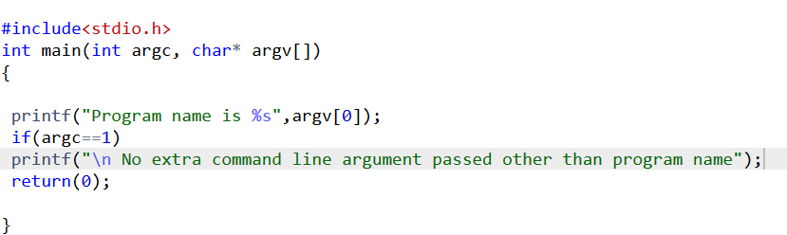
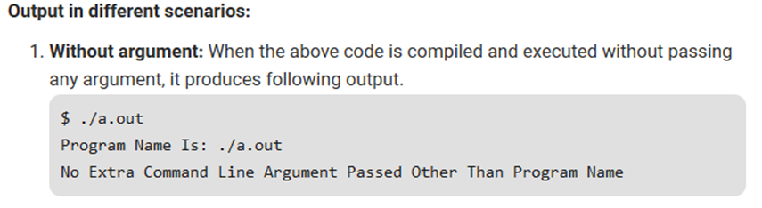
argc is 1 here, which is implicitly passed.
The argument passed is the program name which is ./a.out.

Slide 4
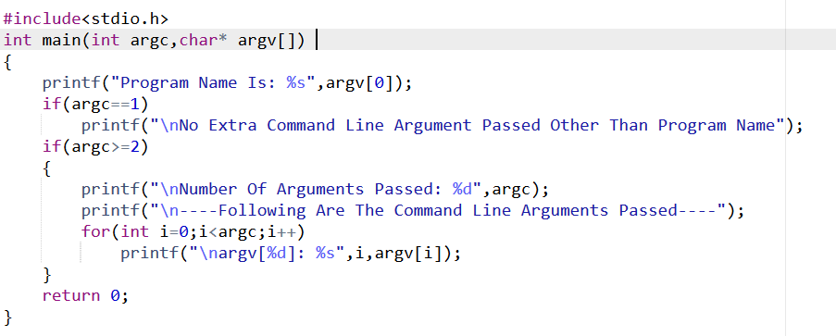

Slide 5
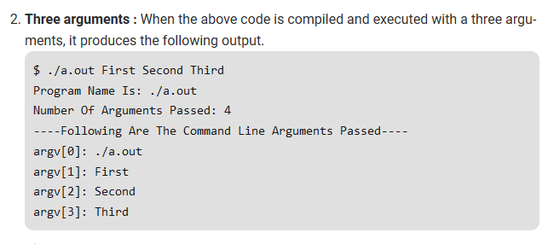
argc is 4 here.
Apart from the program name, there are three more arguments.

Slide 7
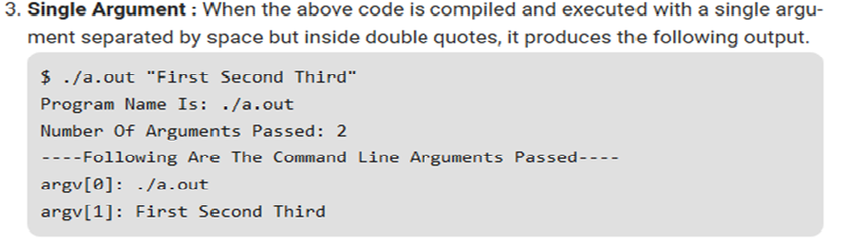
Here, the second argument passed is “First Second Third”.
Since it is enclosed in double quotes, it is considered as a single argument.
Instead of double quotes, we can use single quotes also.

Slide 8
Thank You

